Slide 1
Text Summarization
Deep Learning Models

Slide 2
Text summarization
task of automatically generating a shorter version of a document while preserving its important information and meaning.
Deep Learning–based summarization is mainly divided into:
Extractive summarization – selects important sentences from the original text.
Abstractive summarization – generates new sentences using neural language models.

Slide 3
RNN-Based Summarization
A basic RNN processes a sentence one word at a time.
For example: "The university organized an international AI conference."
The RNN processes: The → university → organized → an → international → AI → conference
h_{t}​=f(W_{x}​x_{t}​+W_{h​}h_{t−1}​+b)
x_{t} = current word representation
h_{t} = current hidden state
h_{t-1} = previous hidden state
The final hidden state attempts to represent the entire input.
Problem: Important information from the beginning can be lost. This is the long-term dependency problem.
Therefore, LSTM and GRU models became more useful.

Slide 4
LSTM for Text Summarization
LSTM introduces gates to control information flow.
Forget Gate, Input Gate, Output Gate
LSTM is therefore better at retaining important information over long sequences.

Slide 5
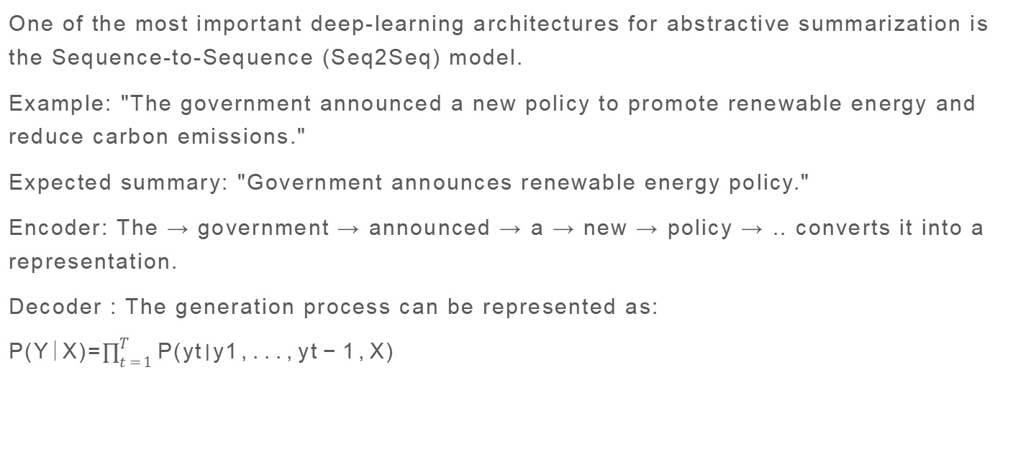
Encoder–Decoder / Seq2Seq Model
One of the most important deep-learning architectures for abstractive summarization is the Sequence-to-Sequence (Seq2Seq) model.
Example: "The government announced a new policy to promote renewable energy and reduce carbon emissions."
Expected summary: "Government announces renewable energy policy."
Encoder: The → government → announced → a → new → policy → .. converts it into a representation.
Decoder : The generation process can be represented as: P(Y∣X)=$\prod_{t=1}^{T}{P(yt​∣y1​,...,yt−1​,X) }$​

Slide 6
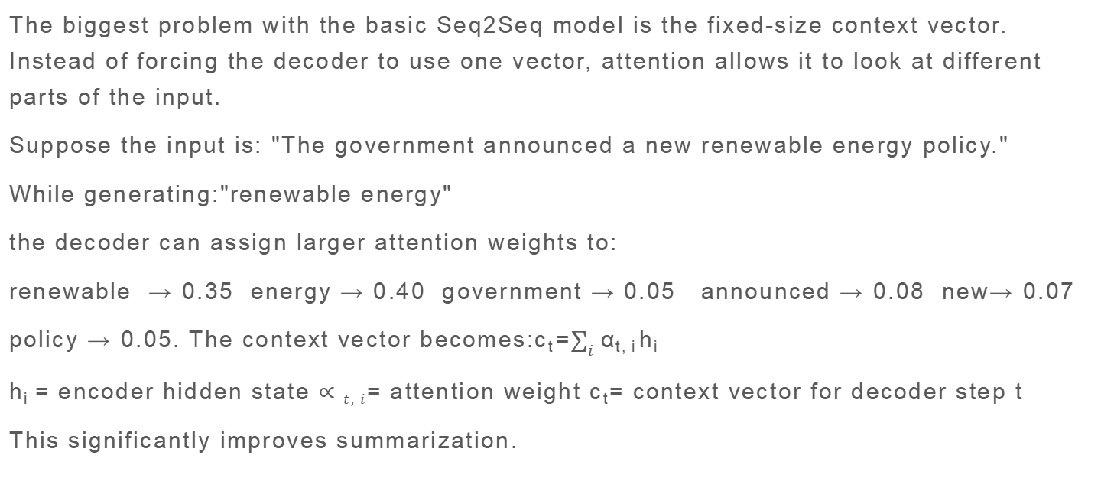
Attention Mechanism
The biggest problem with the basic Seq2Seq model is the fixed-size context vector. Instead of forcing the decoder to use one vector, attention allows it to look at different parts of the input.
Suppose the input is: "The government announced a new renewable energy policy."
While generating:"renewable energy"
the decoder can assign larger attention weights to:
renewable → 0.35 energy → 0.40 government → 0.05 announced → 0.08 new→ 0.07
policy → 0.05. The context vector becomes:c_{t}​=$\sum_{i}{αt,i​hi​ }$​
h_{i} = encoder hidden state $∝t,i$= attention weight c_{t}= context vector for decoder step t
This significantly improves summarization.

Slide 7
Pointer-Generator Network
A major challenge in abstractive summarization is generating rare or unseen words.For example: Input: "Dr. A.P.J. Abdul Kalam..."
A normal vocabulary-based decoder may not generate the exact name correctly.
The Pointer-Generator Network combines:
Generate : Generate a word from the vocabulary.
Copy : Copy a word directly from the source document.
A probability p_{gen} determines whether to generate or copy: P(w)=p_{gen}​P_{vocab}​(w)+(1−p_{gen}​)P_{copy​}(w)
This is especially useful for: names, dates, technical terms, locations, rare words

Slide 8
Transformer-Based Summarization
Modern summarization systems largely use Transformers. Unlike RNNs/LSTMs, Transformers do not process words sequentially. They use self-attention.

Slide 9
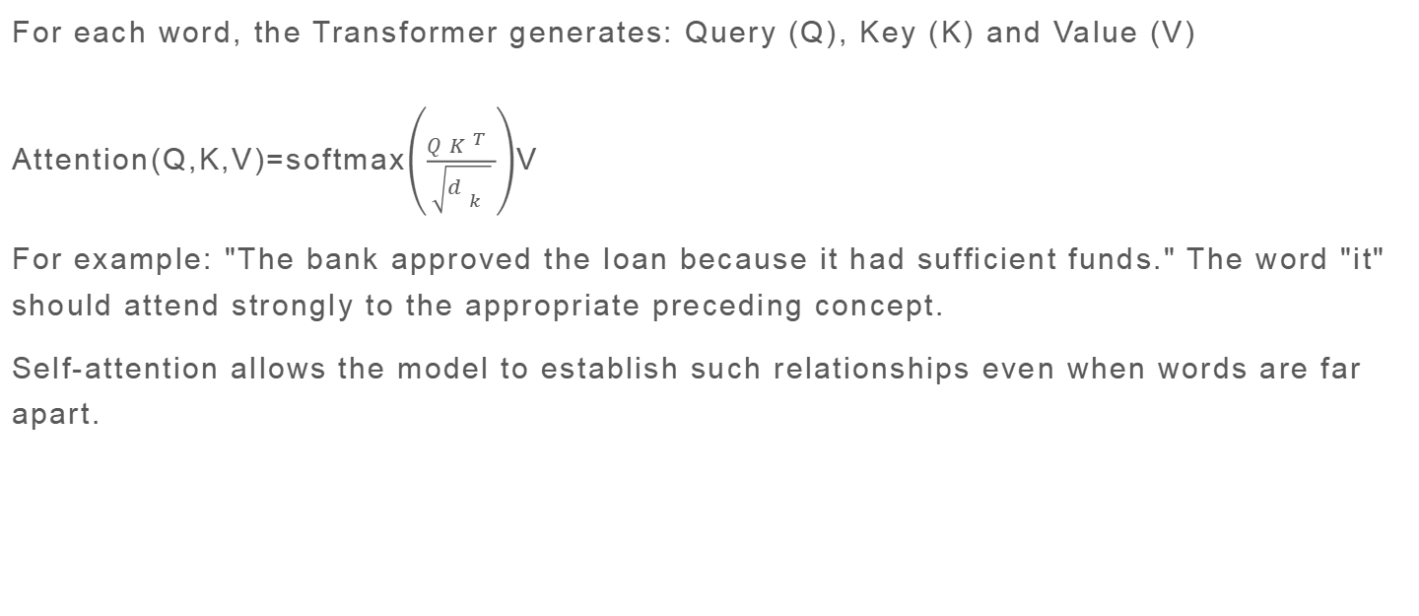
Self-Attention
For each word, the Transformer generates: Query (Q), Key (K) and Value (V)
Attention(Q,K,V)=softmax$\left(\frac{QK^{T}}{\sqrt{d_{k}}}\right)$V
For example: "The bank approved the loan because it had sufficient funds." The word "it" should attend strongly to the appropriate preceding concept.
Self-attention allows the model to establish such relationships even when words are far apart.

Slide 10
BERT for Extractive Summarization
BERT is primarily an encoder-only Transformer. For extractive summarization, the model can assign a score to every sentence.
Document
│
├── Sentence 1 → 0.21
├── Sentence 2 → 0.83 ✓
├── Sentence 3 → 0.31
├── Sentence 4 → 0.76 ✓
└── Sentence 5 → 0.18
The system selects the highest-scoring sentences.
Therefore: BERT → commonly used for extractive summarization
while encoder-decoder models such as BART/T5 are better suited to generation.

Slide 11
BART
BART is a Transformer encoder-decoder model. It is pretrained by corrupting text and asking the model to reconstruct the original text.
Example:
Original: The university organized an international AI conference.
Corrupted: The university _____ an international _____ conference.
↓
BART
↓
The university organized an international AI conference.
After pretraining, it can be fine-tuned for summarization. BART is particularly effective for abstractive summarization because the decoder can generate fluent new text.

Slide 12
T5
T5 = Text-To-Text Transfer Transformer. T5 converts NLP tasks into a text-to-text format.
For summarization: Input:
summarize: The university organized an international AI conference...
↓ T5
Output: University organizes international AI conference.

Slide 13
PEGASUS
PEGASUS was designed specifically with summarization in mind.
Its important pretraining objective is Gap Sentence Generation.
Suppose the document contains:
S1: Artificial intelligence is transforming healthcare.
S2: Hospitals are adopting AI-based diagnostic systems.
S3: These systems can identify diseases earlier.
The model may remove an important sentence:
S1: Artificial intelligence is transforming healthcare.
S2: [MASKED]
S3: These systems can identify diseases earlier.
The model learns to generate the missing important sentence.
This makes the pretraining task closely related to summarization.

